Slide 1
Culturally Responsive Education: How BOCES Support Districts!
Marijo Pearson, PhD
Assistant Superintendent for Curriculum, Instruction and Professional Development
Monroe 2-Orleans BOCES

Slide 2
Google Folder!

Slide 3
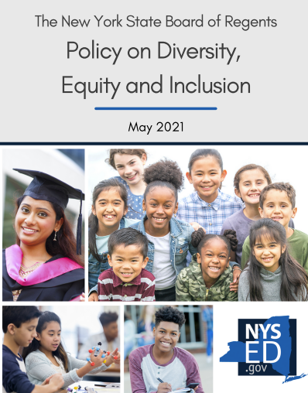
BOCES Support: Anchoring Our Work!
Board of Regents DEI Initiative Overview:
Board of Regents Policy Statement:

Slide 4
NYSED Culturally Responsive Education Resources

Slide 5
All Work Begins with Clarifying Language!

Slide 6
Defining Culturally-Responsive Sustaining Education
The information below is taken from NYSED Culturally Responsive-Sustaining Education Framework.
The Culturally Responsive-Sustaining (CR-S) framework is intended to help education stakeholders create student-centered learning environments that affirm cultural identities; foster positive academic outcomes; develop students’ abilities to connect across lines of difference; elevate historically marginalized voices;
This vision is grounded in Gloria Ladson-Billings’ early work on culturally relevant teaching, specifically the three criteria for culturally relevant pedagogy she puts forth in Ladson-Billings (1995). The New York State Culturally Responsive-Sustaining Framework includes guidelines for students, teachers, school leaders, district leaders, families and community members, higher education faculty, and Education Department policymakers. For guidelines to be effective, all stakeholders must work together, prioritize and implement systems and structures that facilitate the scale of culturally responsive-sustaining practices, and hold each other accountable to short- and long-term goals.

Slide 7
What does it mean to be a culturally responsive school community?

Slide 8
Defining Culturally-Responsive Sustaining Education
Partnerships, high expectations, and student-driven instruction.

Slide 9
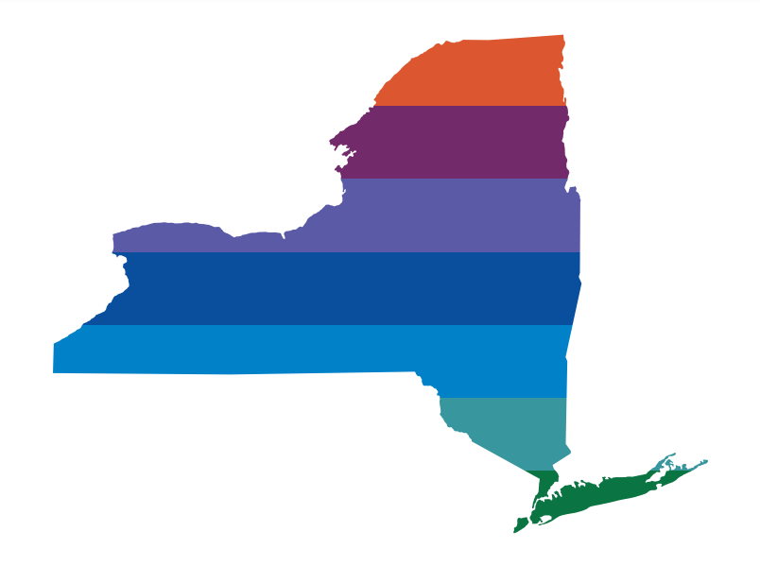
Stakeholder Groups
Notes:
L

Slide 10
Defining C-RSE: Stakeholder Engagement
When stakeholders work together to implement culturally responsive-sustaining practices, educators will grow in their ability to be:
Socio-politically Conscious
Socio-culturally Responsive
Demonstrate excellence by bring inclusive-minded and asset-focused
Identify and critically examine both historical and contemporary power structures
Reflect, honor, value, and center various identity perspectives as assets in policies and practices (Sue, 2001)
Engage in critical conversations
Recognize that personal, cultural, and institutionalized discrimination creates and sustains privileges for some while creating and sustaining disadvantage for others
Commit to understanding the role of culture in education as flexible, local, and global
Act as agents of social change to redress historical and contemporary oppression
Build alliances across difference to eradicate all forms of discrimination
Engage in current and historical issues
Practice mutual respect for qualities and experiences that are different from one’s own

Slide 11
Defining C-RSE: Language and Expectations
The Language and Communication of High Expectations
"When a teacher expresses sympathy over failure, lavishes praise for completing a simple task, or offers unsolicited help, the teacher may send unintended messages of low expectations." Kathleen Serverian-Wilmeth.
It is critical to know that you may have students in your classroom that come from homes where the language and culture do not necessarily correspond to the language and culture of their school. This lack of alignment between home and school may be a disadvantage to students' learning process and cause them to be disengaged in school.

Slide 12
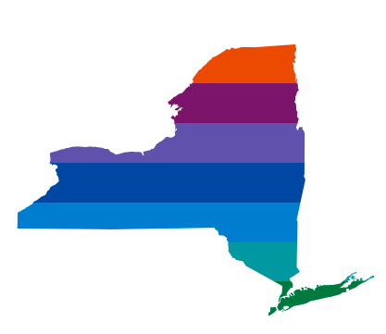
Defining C-RSE: Student-Driven Instruction
Rigorous Student-Driven Instruction
"Authentic and relevant learning frame curriculum and content for students. A shift from traditional teacher-centered instruction to student-driven instruction should include a problem or challenge that students are addressing and aiming to solve. The inclusion of current events, community issues and needs, and projects related to social justice are all ways to provide students with rigorous instruction that can be culturally responsive.
The shift from a teacher-centered to a student-driven classroom allows the teacher to leave the front of the room and directly engage with students during the learning process. The "guide on the side" can gain a clear sense of student learning and use that knowledge to drive instruction so that all students are challenged to reach their potential.

Slide 13
BOCES: Supporting our Districts
Provide Professional Development on the following:
NYSED Culturally Responsive Framework (briefs, etc.)
NYU Cohort Trainings: Principles of Culturally Responsive Education
Book Studies: Cultivating Genius by Gholdy Muhammad; White Fragility by Dr. Robin DiAngelo; Our Children are Greatly in Danger by Justin Murphy
Diversity Equity and Inclusion CoSer
Regional Equity Network Professional Learning Communities
Curriculum Development – Equity Lens
Race, Class and Inequities Inquiries
Technical Assistance:
Curriculum Review tools

Slide 14
Helpful Questions for Creating Culturally Responsive & Inclusive Curriculum
How does my teaching engage diverse and/or underrepresented populations?
How does my curriculum acknowledge various perspectives and/or voids?
How do my lessons foster an inclusive classroom community?
How do my course materials reflect my current students?
How is attention to diverse perspectives included in my planning?
Adapted From: https://guides.library.pdx.edu/c.php?g=527355&p=3605354
Notes:
L

Slide 15
Race, Class, and Inequities Project
The purpose of this collaborative project is to develop common units of study to be included in the curriculum across all of our schools that will focus on how race, class and inequities have shaped our region from 1964 to today.
Let’s Take a Look:
Race, Class and Inequities Inquiry Project (monroe2boces.org)
Password: FAIR
Notes:
FAIR

Slide 16
QUESTIONS

