Slide 1
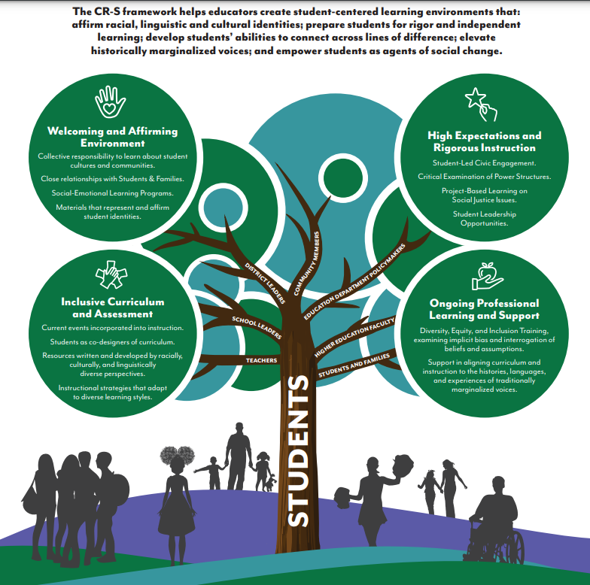

Slide 2
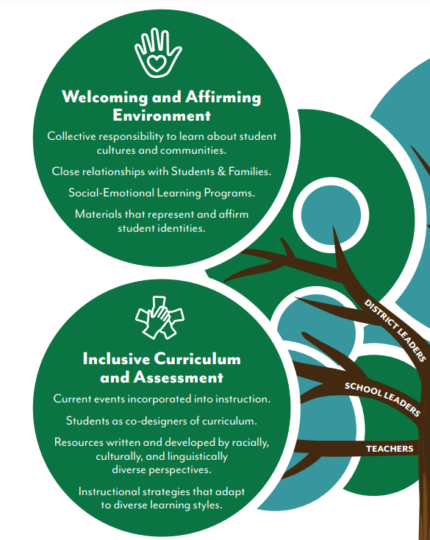
Today we will focus on the left two sections of the graphic:
Welcome and Affirming Environment
and
Inclusive Curriculum and Assessment

Slide 3
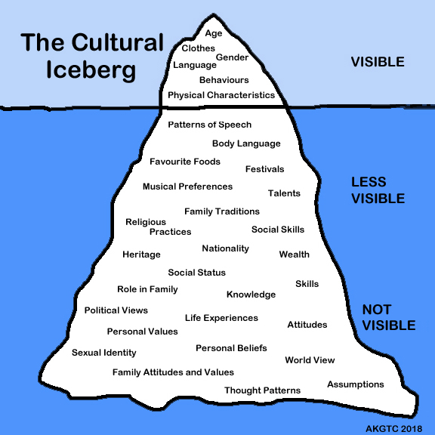
Tip: The Cultural Iceberg is something to keep in mind as you think about the characters, themes, and perspectives in diverse books.

Slide 4
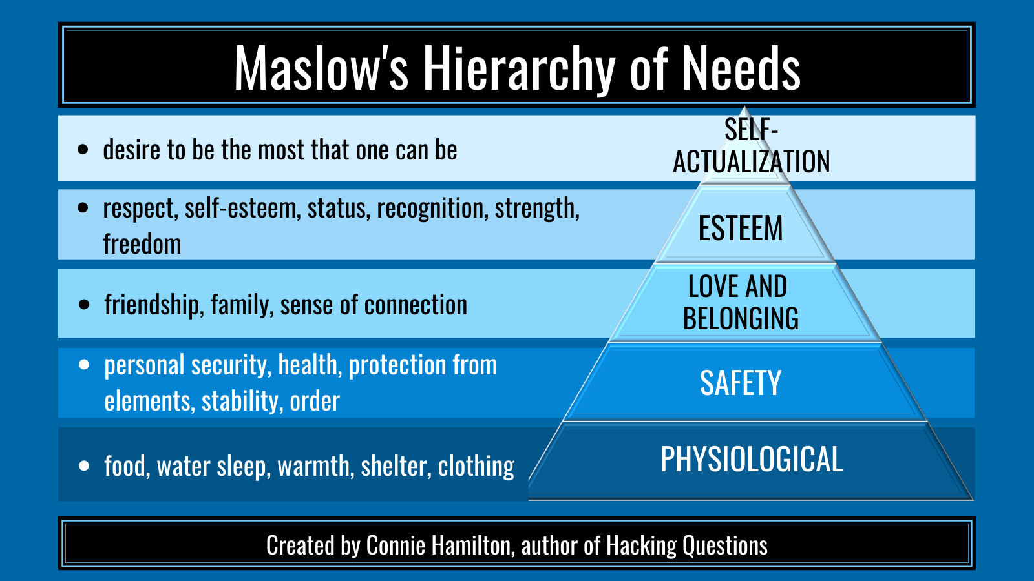
Tip: “Maslow before Bloom” means that meeting basic needs of students will help them learn.

Slide 5
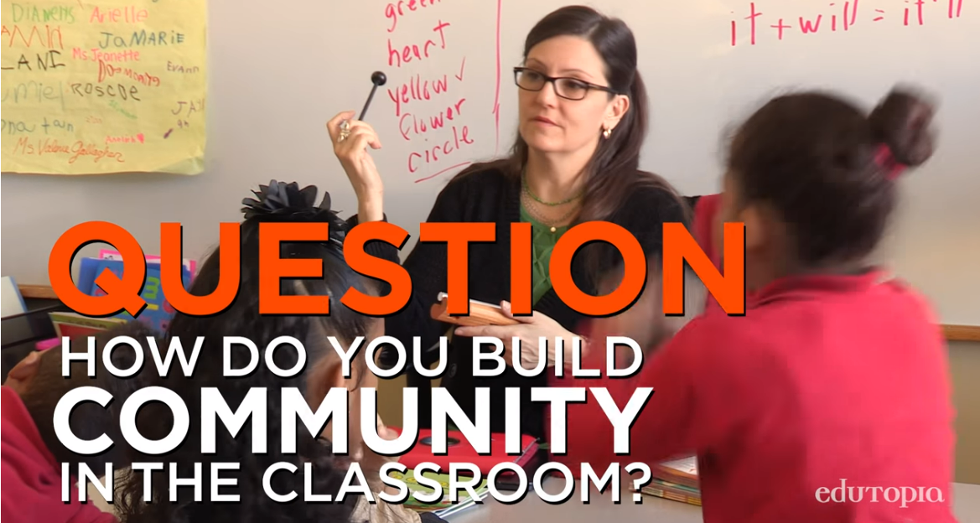
Link: 10 Powerful Community-Building Ideas | Edutopia
Video: 60-Second Strategy: Shout Outs

Slide 6
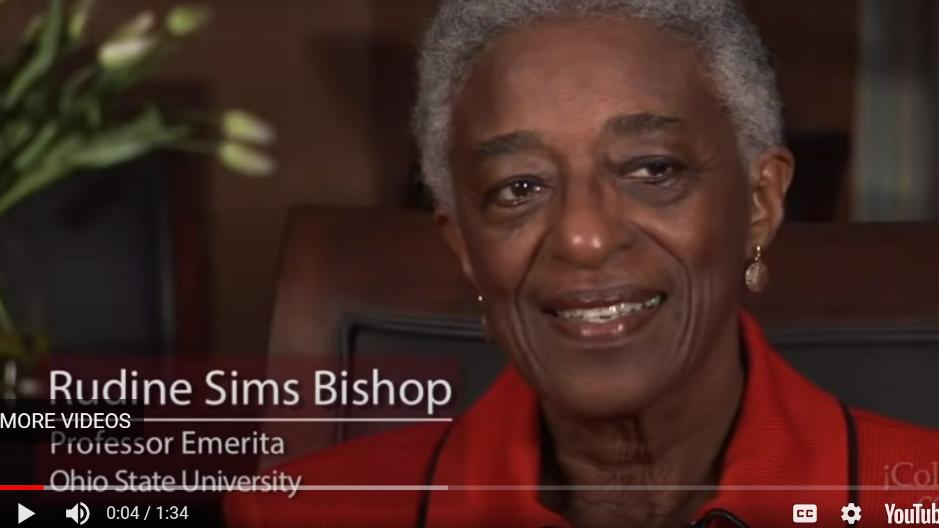
Dr. Rudine Sims Bishop: Professor Emerita, The Ohio State University
Diverse books in the classroom, all year round
Celebrating children through poetry
Change in the “All White World of Children’s Literature”
https://www.youtube.com/watch?v=_yQ49ItLMJ0
#WeNeedDiverseBooks
Beyond folk, food and festivals
https://www.youtube.com/watch?v=dwK4VArdANU

Slide 7
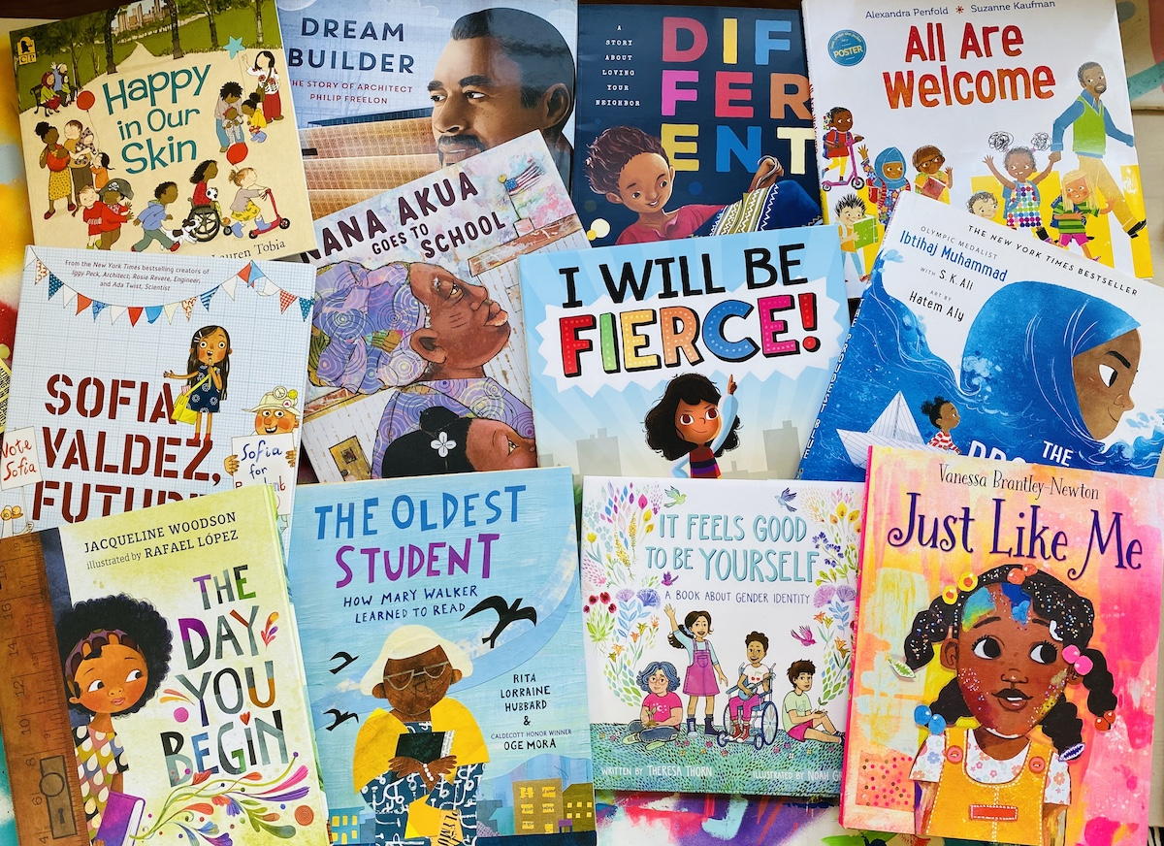

Slide 8
Tip from Kelsey Biteto (formerly Kelsey Rising):
Notes:
https://docs.google.com/presentation/d/1RqGY_eETfmyzQTprFGvUByZyHzP8VFlN9sCS2lM3o6w/edit?usp=sharing

Slide 9
Tip: If kids are inspired to want to change the world, opinion writing will be a breeze!

Slide 10
Opinion Writing Connection:
Kids can change the world!
Video:
More than Peach by Bellen Woodard;
Illustrated by Fanny Liem
Website: Bellen's More than Peach Project

Slide 11
Lift a Line
Strategy 13.13 (Reading Strategies book)
Choose a line meaningful line from the text.
Type the line and distribute it to students.
Students glue it in their notebooks and respond.
What does that mean to you?
React to the line in writing. Be ready to share with your literacy partner.
Students share-out in small groups.

Slide 12
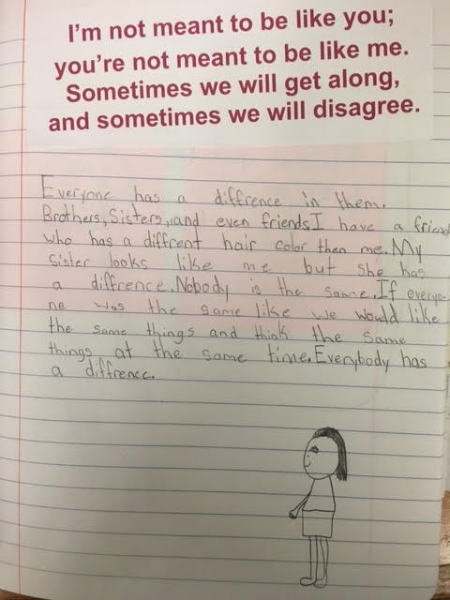

Slide 13
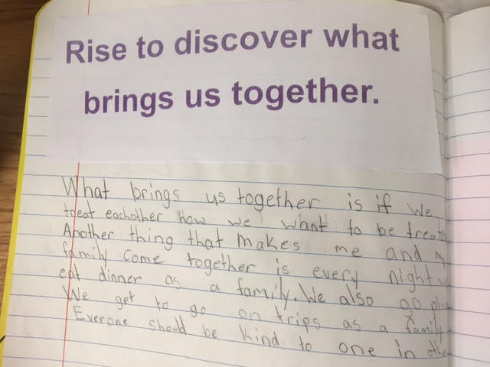

Slide 14
Thinking about the Character
Feeling: an emotion that changes (can change in a story)
Trait: what the character is like on the inside (doesn’t usually change)
How are you feeling?
What are your character traits?

Slide 15
Brian
Feeling Trait
(an emotion that changes) (what the character is like on the
inside - usually doesn’t change)

Slide 16
You
Feeling Trait
(an emotion that changes) (what the character is like on the
inside - usually doesn’t change)

Slide 17
Read More Where Did BIPOC Come From?
Tip: Stay open-minded and adapt as our society adopts new terminology.
Read More The BIPOC Project

Slide 18
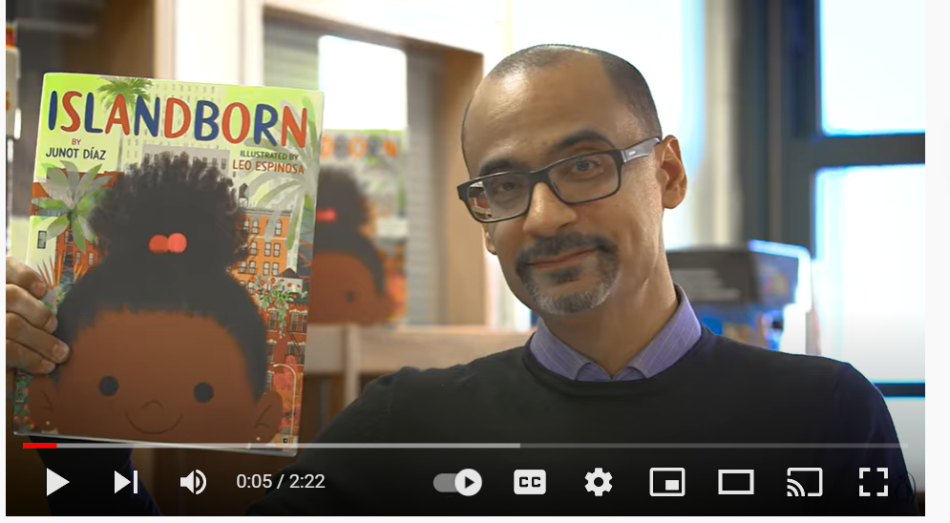
JUNOT DÍAZ introduces ISLANDBORN
Tip: Not knowing how to pronounce a name and finding out how to pronounce it the right way is great to model in front of students!
Tip: Sharing video clips and various background information prior to reading the book might increase engagement.

Slide 19
What is your story?
Where did you come from?
Is there a place you lived before today?
What stories does your
family tell?

Slide 20
Video: Mirrors, Windows and Sliding Glass Doors
Mirrors: children see themselves reflected
in the books they read
Windows: children look through and see other worlds
Sliding glass doors: allow children to enter the other worlds
Tip:
Name to remember: Dr. Rudine Sims Bishop
Click here to watch more videos! Link to later slides in this presentation

