Slide 1
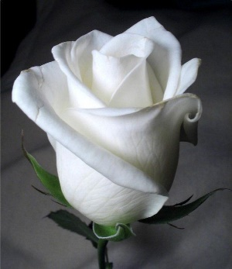
73rd DKG NYS Organization Convention Hour of Remembrance A Celebration of Life
New York State Organization

Slide 2
Leader: We have come to remember or sisters
Assembly: Though not with us, we remember them
in love.
Leader: They are the ones who taught our children.
Assembly: Though not with us, we remember them in love.
Leader: We place a rose, a white rose for our sisters.
Assembly: Though not with us, we remember them in love.
Leader: Symbol of hope is the rose we cherish.
Assembly: Though not with us, we remember them in love.
New York State Organization
RESPONSIVE READING
“We Remember them in Love”

Slide 3
Now that I am gone,
Remember me with smiles and laughter.
And if you need to cry,
Cry with your sister
Who walks in grief beside you.
And when you need me,
Put your arms around anyone
And give to them what you need to give to me.
There are so many who need so much,
Want to leave you something-
Something much better than words or sounds.
Look for me in the people I’ve known
or helped in some special way.
Let me live in your heart
As well as in your mind.
You can love me most
By lettering your love reach out to our loved ones,
By embracing them and living in their love.
Love does not die, people do.
So, when all that’s left of me is love,
Give me away as best you can.
-Author Unknown
New York State Organization
READING SELECTON
“A Sister Remembered”

Slide 4
Add Chapter Member’s Name
New York State Organization
IN LOVING MEMORY
Hour of Remembrance
The Delta Kappa Gamma Society International
NYS Organization
In Memoriam 2019-2021

Slide 5
Add Chapter Member’s Name
New York State Organization
IN LOVING MEMORY
Hour of Remembrance
The Delta Kappa Gamma Society International
NYS Organization
In Memoriam 2019-2021

Slide 6
Add Chapter Member’s Name
New York State Organization
IN LOVING MEMORY
Hour of Remembrance
The Delta Kappa Gamma Society International
NYS Organization
In Memoriam 2019-2021

Slide 7
New York State Organization
Moment of Silence
At this time we would like to pause and remember all our fellow sisters who have departed from us. We cherish the memory of their friendship.

Slide 8
Leader: For all the members of Delta Kappa Gamma Society International
Assembly: We remember and give thanks
Leader: For our departed sisters who have served in the field of education
Assembly: We remember and give thanks
Leader: For all the students they inspired and enriched
Assembly: We remember and give thanks
Leader: For the time and talent they gave to their local Chapters, Area Councils and NY State
Assembly: We remember and give thanks
Leader: For their friendship, kind words and support
Assembly: We remember and give thanks
Leader: For their belief in and devotion to the purposes of our Society
Assembly: We remember and give thanks
Leader: For the families, friends and colleagues who shared our departed sisters with us
Assembly: We remember and give thanks
New York State Organization
RESPONSIVE READING

Slide 9
New York State Organization

